Slide 1
Borrower Loan Analytics Reports

Slide 2
Requirements:

Slide 3
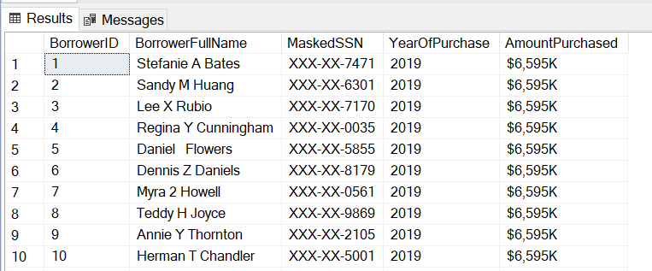
Report 1

Slide 4
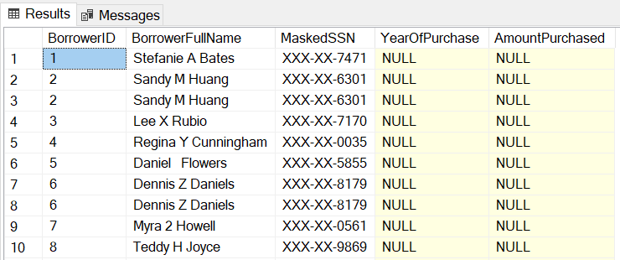
Report 1b

Slide 5
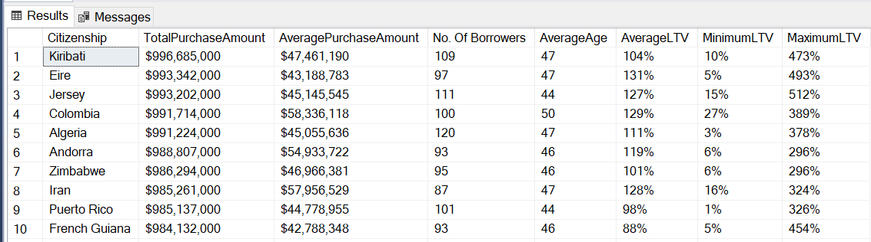
Report 2a

Slide 6
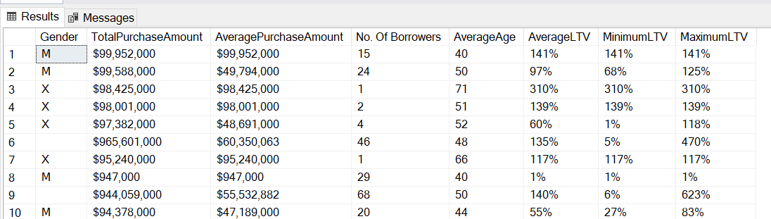
Report 2b

Slide 7
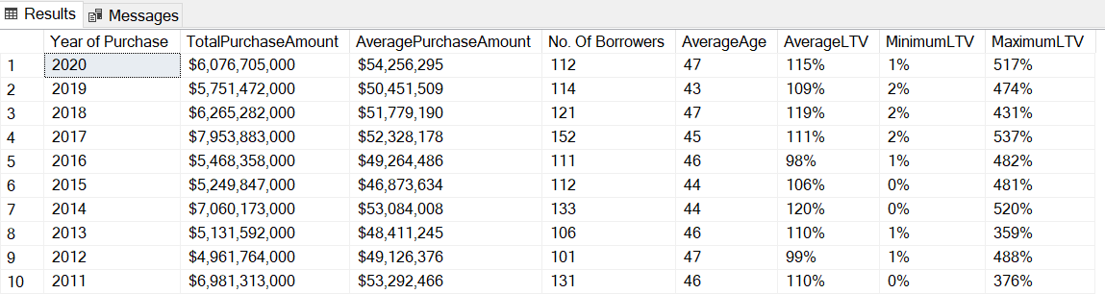
Report 2c

Slide 8
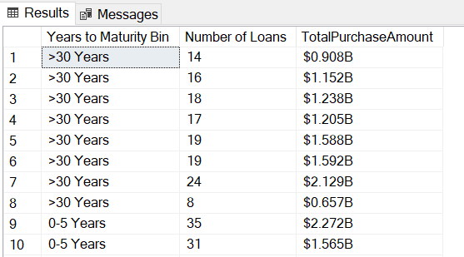
Report 3

Slide 9
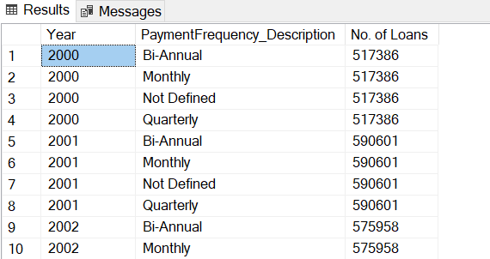
Report 4

